Slide 1

DR B R AMBEDKAR NATIONAL INSTITUTE OF TECHNOLOGY, JALANDHAR (144011)
MINOR PROJECT
Plant Disease Detection using Deep Learning
MENTORED BY: SUBMITTED BY:
Prof A L Sangal Gunika (20103061)
Professor (HAG) Samneet Singh (20103128)
Department of CSE Tanish Jindal (20103149)

Slide 2
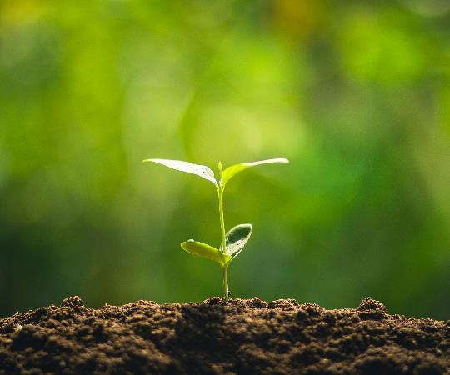

Contents
Introduction
Literature Survey
Proposed Approach
Methodology
Implementation
Result and Conclusion
Future Scope
References

Slide 3
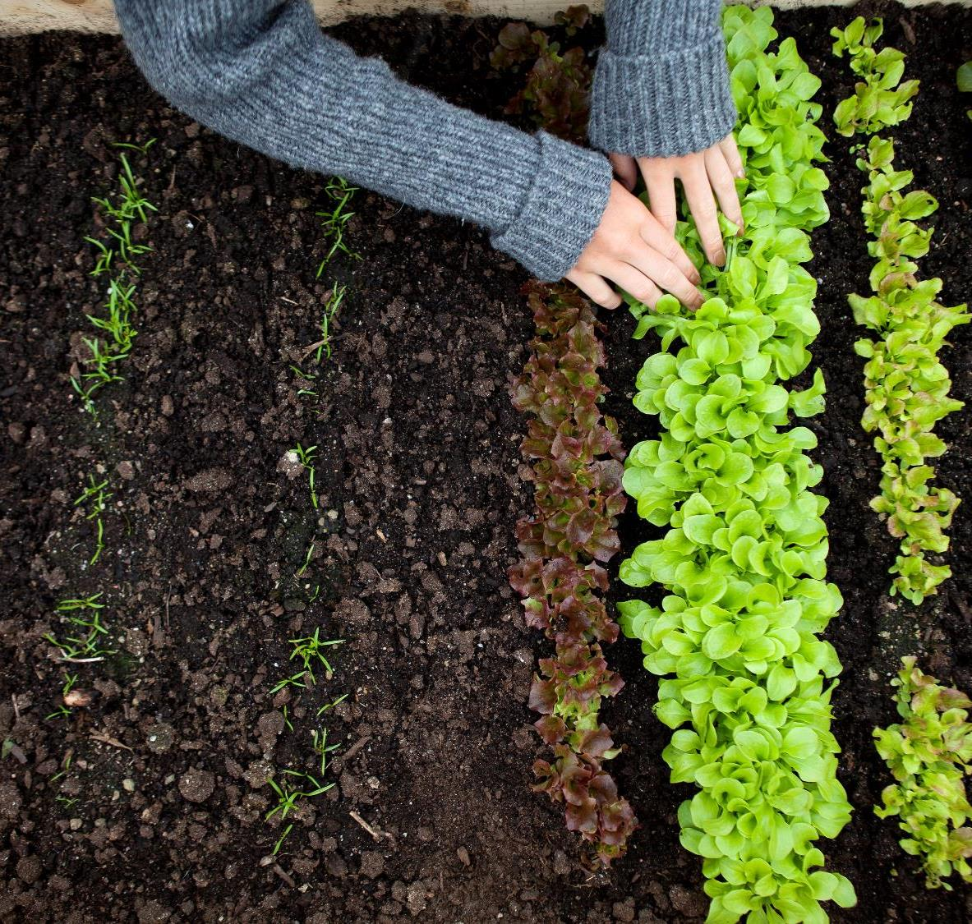
Introduction
The occurrence of plant diseases has a negative impact on agricultural production. If plant diseases are not discovered in time, food insecurity will increase[1].
Early detection is the basis for effective prevention and control of plant diseases for management and decision making of agricultural production.
In most cases, agricultural and forestry experts are used to identify on-site or farmers identify fruit tree diseases and pests based on experience.
This method is not only subjective, but also time-consuming, laborious, and inefficient[2].

Slide 4

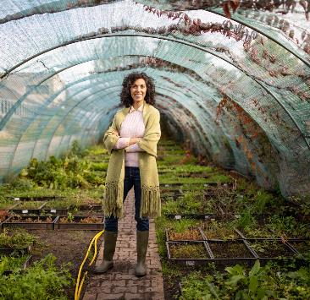
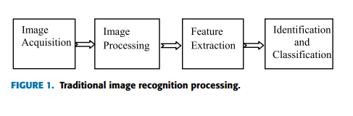
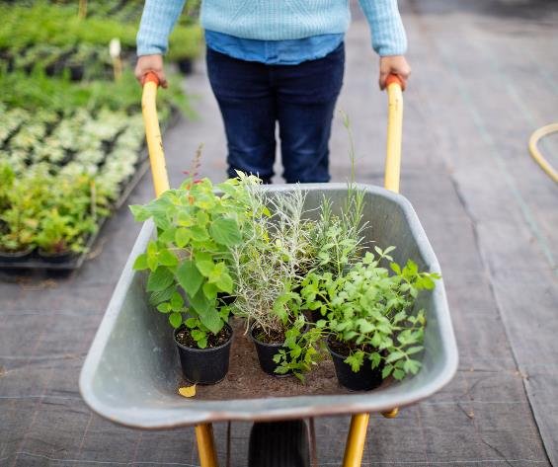
Literature Review
To prevent farmers with less experience from using drugs blindly during the identification process, research into the use of image processing techniques for plant disease recognition has become a hot research topic [3].
Chai et al. [4] studied four tomato leaf diseases, including early blight and late blight leaf mildew and leaf spot.
He extracted 18 characteristic parameters such as color, texture, and shape information of tomato leaf spot images, using stepwise discriminant and Bayesian discriminant principal component analysis (PCA), respectively.

Slide 5
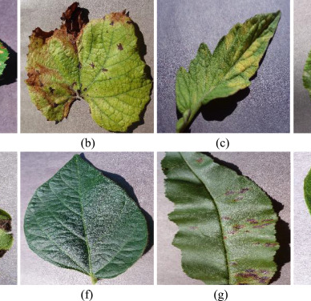
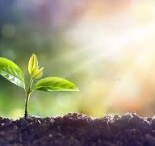
Literature Review (contd.)
Traditional practices are heavily dependent on artificial feature extraction. However, Deep learning (DL) technology can automatically extract image features and classification of plant disease spot is done.
Also, CNN is preferred over ANN as especially, in the case of image data being pixel values of the images as features, the number of input features would be of large dimension, leading to increase in the number of parameters to be learned [5].
CNN reduce the number of units in the network, which means fewer parameters to learn and reduced chance of over-fitting.

Slide 6


Our Proposed Approach
In an era when smart agricultural technology is so advanced, mobile phones have become a new type of ‘‘farming tool’’ for farmers, which can help farmers in identifying diseases and insect pests.
The farmer takes pictures and uploads the diseased parts of the crop, and the system will return the recognition result within a few seconds. And provide users with the diagnosis results, similarity, disease characteristics, causes, and prevention and control plans for users, so that farmers can treat diseases and insects in a scientific way and increase crop yields.
In addition to real time and fully automatic detection of crop pests and diseases, the system also implements a series of supporting functions such as prevention and control recommendations and drug recommendations.

Slide 7

What we plant in the soil of contemplation , we shall reap in the harvest of action .
-Meister Eckhart

Slide 8
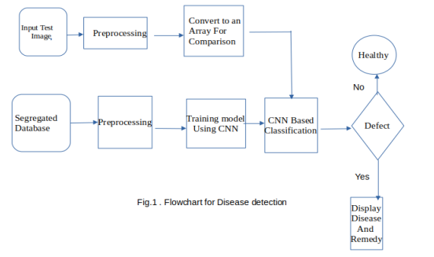
Methodology
Preprocessing and Training the model (CNN):
In this data-set, 39 different classes of plant leaf and background images are available. The data-set contains 61,486 images.
We used Image reshaping, resizing, cropping to transform the dataset. There are a total of 39 classes that we aim to predict using the CNN model.
The train database is used to train the model (CNN ) so that it can identify the test image and the disease it has (as shown in Figure 1)
After the model is trained successfully ,the software can identify the disease for the test image.

Slide 9
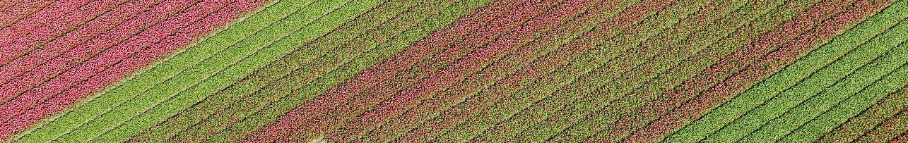
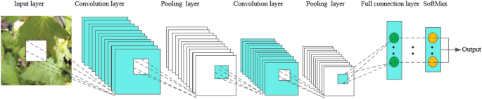
Technique
Upload the Input image (from mobile, camera, drone)
Resize every image into 224 x 224.
Feed into the Convolutional Neural Network. (3 channels RGB)
First layer we apply 32 filter size to create a features map. (3 x 224 x 224→32 x 222 x 222)
ReLU activation function to remove non linearity.
Feed to the max pool layer which takes only the most relevant features (output image in shape 32 x 112 x 112).
VII. Similar process for next convolutional layer
At last, we and feed to the next fully connected layer, and finally, as a final layer, we predict 39 categories. So as a model output →1x39 to predict the disease.
{yes}find remedies based on disease detected
End

Slide 10
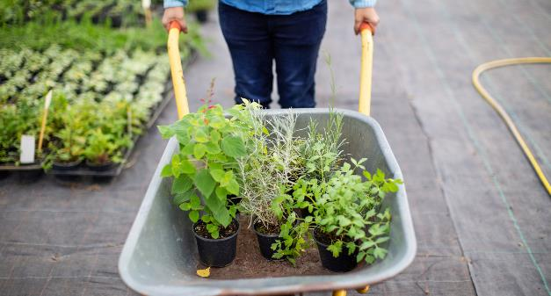
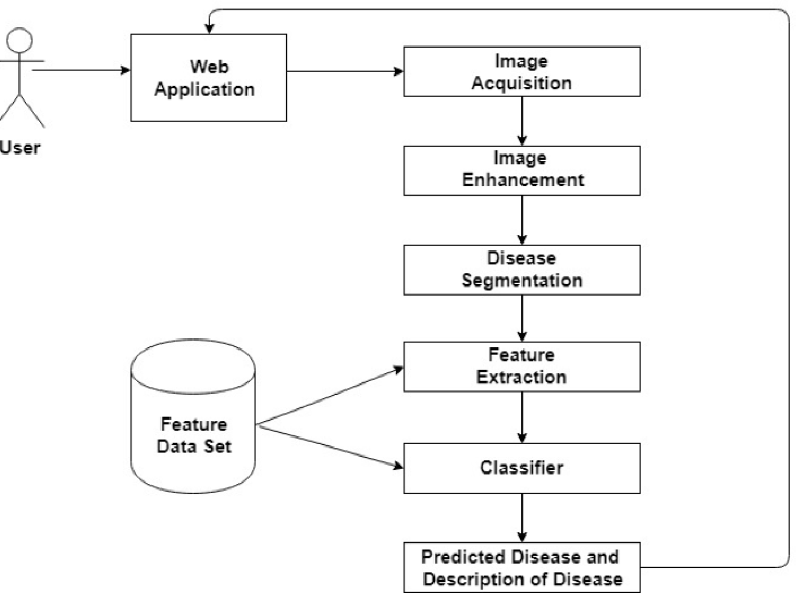
System Architectural Flow
Subtite

Slide 11

Home Page

Slide 12
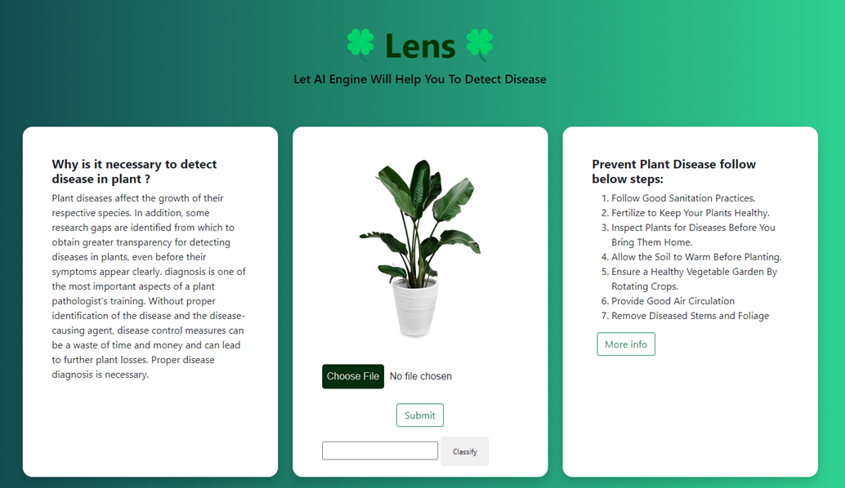
Lens

Slide 13
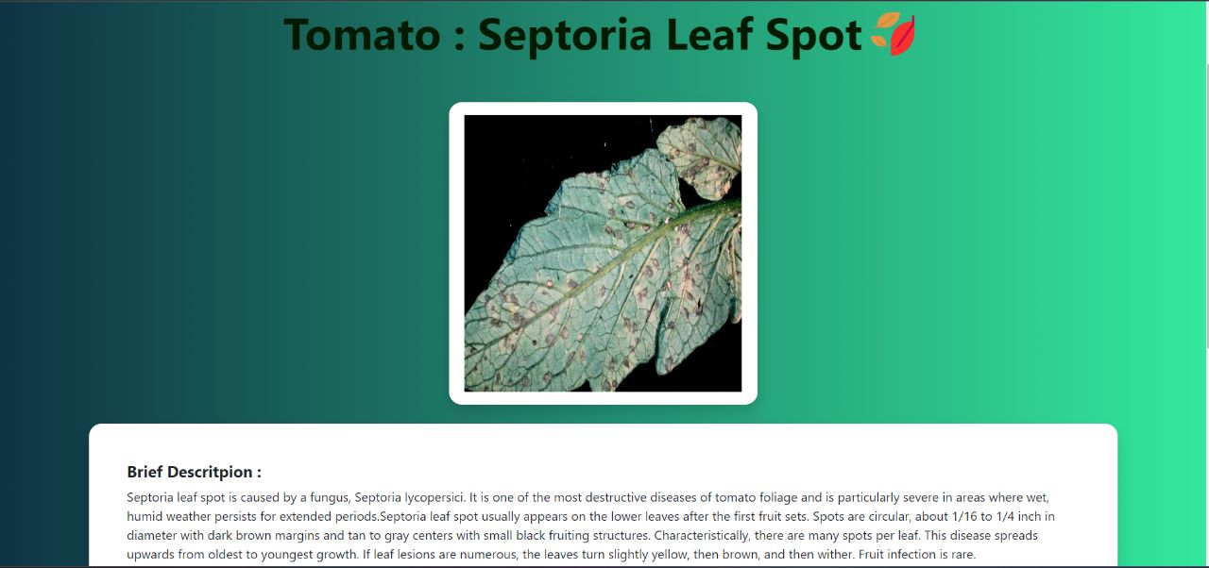
Disease Detected

Slide 14
Results
We can observe that the accuracy scores are nearly equal to f1 scores. This is because of balanced number of false negative and false positive predictions. This is considered as best case for any machine learning algorithm. The average accuracy was 93%.

Slide 15
Improvements Needed
For the datasets with only a few or dozens of images, the transfer learning method also has the problem of low recognition accuracy.
This is because it is difficult for the deep network to learn different features, which leads to problems that are difficult to converge. Therefore, plant disease datasets with single or small samples can hardly support the training of DL architecture.
However, DL classifiers lack interpretability and transparency. The DL classifiers are often considered black boxes without any explanation or details about the classification mechanism.
High accuracy is not only necessary for plant disease classification but also needs to be informed how the detection is achieved and which symptoms are present in the plant.

Slide 16

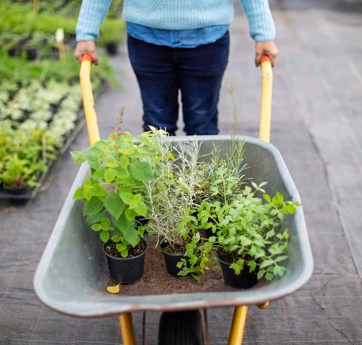
Future Scope
Most of the DL frameworks proposed in the literature have good detection effects on their datasets, but the effects are not good on other datasets, that is the model has poor robustness.
Therefore, better robustness DL models are needed to adapt the diverse disease datasets.
Although some studies are using hyperspectral images of diseased leaves, and some DL frameworks are used for early detection of plant leaves diseases, problems that affect the widespread use of HSI in the early detection of plant diseases remain to be resolved.
That is, for early plant disease detection, it is difficult to obtain the labeled datasets, and even experienced experts cannot mark where the invisible disease symptoms are, and define purely invisible disease pixels, which is very important for HSI to detect plant disease.

Slide 17
References
[1] F. Fina, P. Birch, R. Young, J. Obu, B. Faithpraise, and C. Chatwin, ‘‘Automatic plant pest detection and recognition using k-means clustering algorithm and correspondence filters,’’ Int. J. Adv. Biotechnol. Res., vol. 4, no. 2, pp. 189–199, Jul. 2013.
[2] L. Li, S. Zhang and B. Wang, "Plant disease detection and classification by deep learning—A review", IEEE Access, vol. 9, pp. 56683-56698, 2021.
[3] J. G. A. Barbedo, ‘‘Factors influencing the use of deep learning for plant disease recognition,’’ Biosyst. Eng., vol. 172, pp. 84–91, Aug. 2018.
[4] A.-L. Chai, B.-J. Li, Y.-X. Shi, Z.-X. Cen, H.-Y. Huang, and J. Liu, ‘‘Recognition of tomato foliage disease based on computer vision technology,’’ Acta Horticulturae Sinica, vol. 37, no. 9, pp. 1423–1430, Sep. 2010.
[5] Dinesh, “CNN vs MLP for Image Classification,” medium.com, para 1, [Online] Available: https://medium.com/analytics-vidhya/cnn-convolutional-neural-network-8d0a292b4498

Slide 18


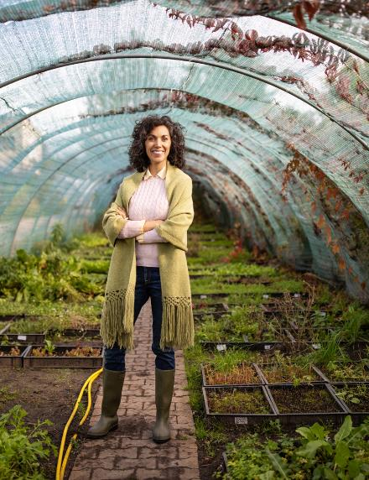
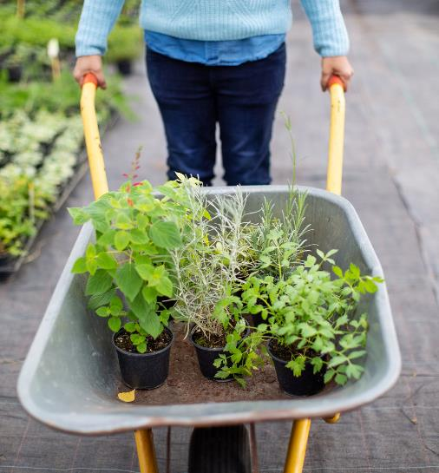

Thank You
.

